Slide 1
AI JOB EXPOSURE
IN THE U.S. ECONOMY
A Speculative Regression Framework with Agent-Based Policy Simulation
Dylan Myers | May 2026

Slide 2
MOTIVATION
Are We Cooked? "What makes a job structurally vulnerable to AI — and does policy determine whether that vulnerability becomes a crisis?"
I'm an Economics major.
This summer I start an internship at a wealth management firm.
My job: analyze data, write reports, coordinate clients.
Those are exactly the tasks AI is getting good at — fast.
So I got scared. And I started measuring it.
At-risk occupations:
Financial Analyst
AIOE: High
HR Specialist
AIOE: High
Marketing Coordinator
AIOE: High
Data Entry Clerk
AIOE: Very High

Slide 3
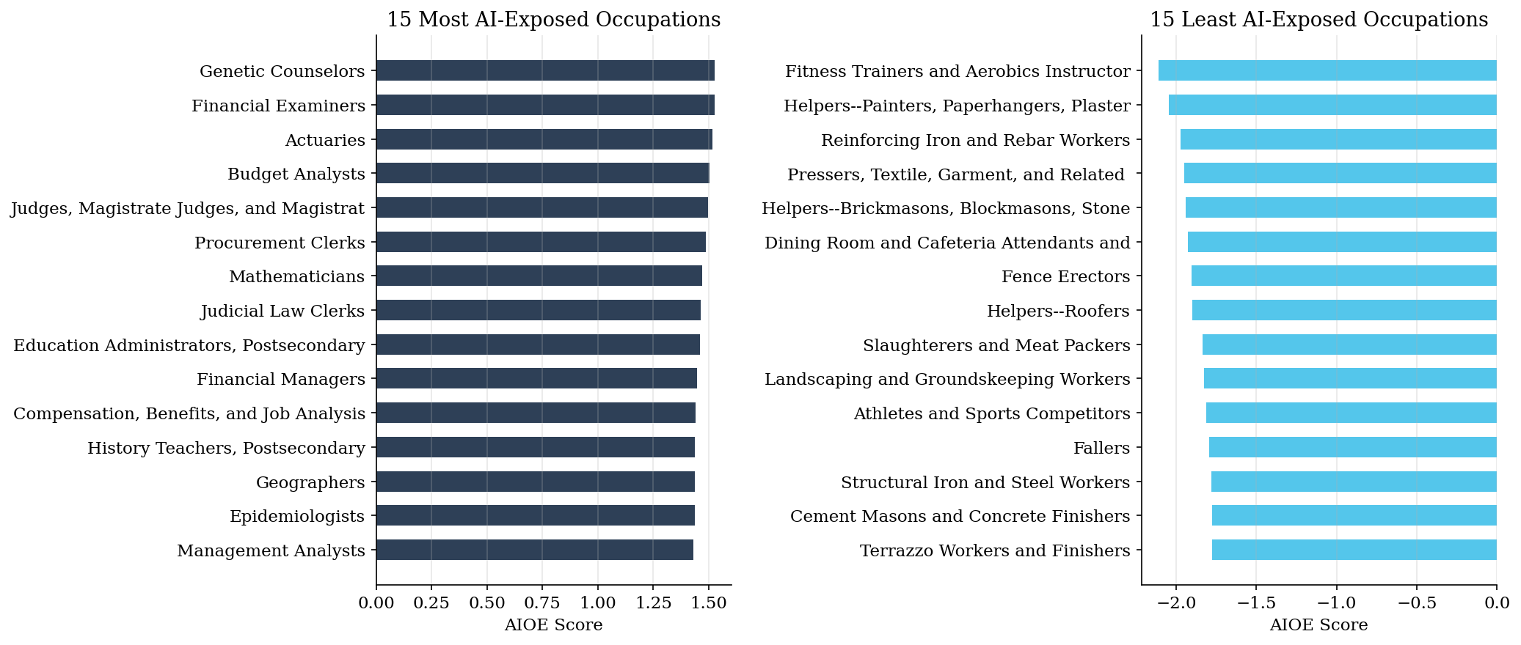
THE TOOL
Defining AI Exposure: The AIOE Score
AI Occupational Exposure (AIOE) Felten, Raj & Seamans (2021) Maps AI capabilities onto O*NET occupational task requirements.
One score per occupation.
Higher = more exposed to AI.
[ top_bottom_occupations.png ]
LOW EXPOSURE → Construction, Nurses, Trades
HIGH EXPOSURE → HR, Analysts, Data Entry

Slide 4
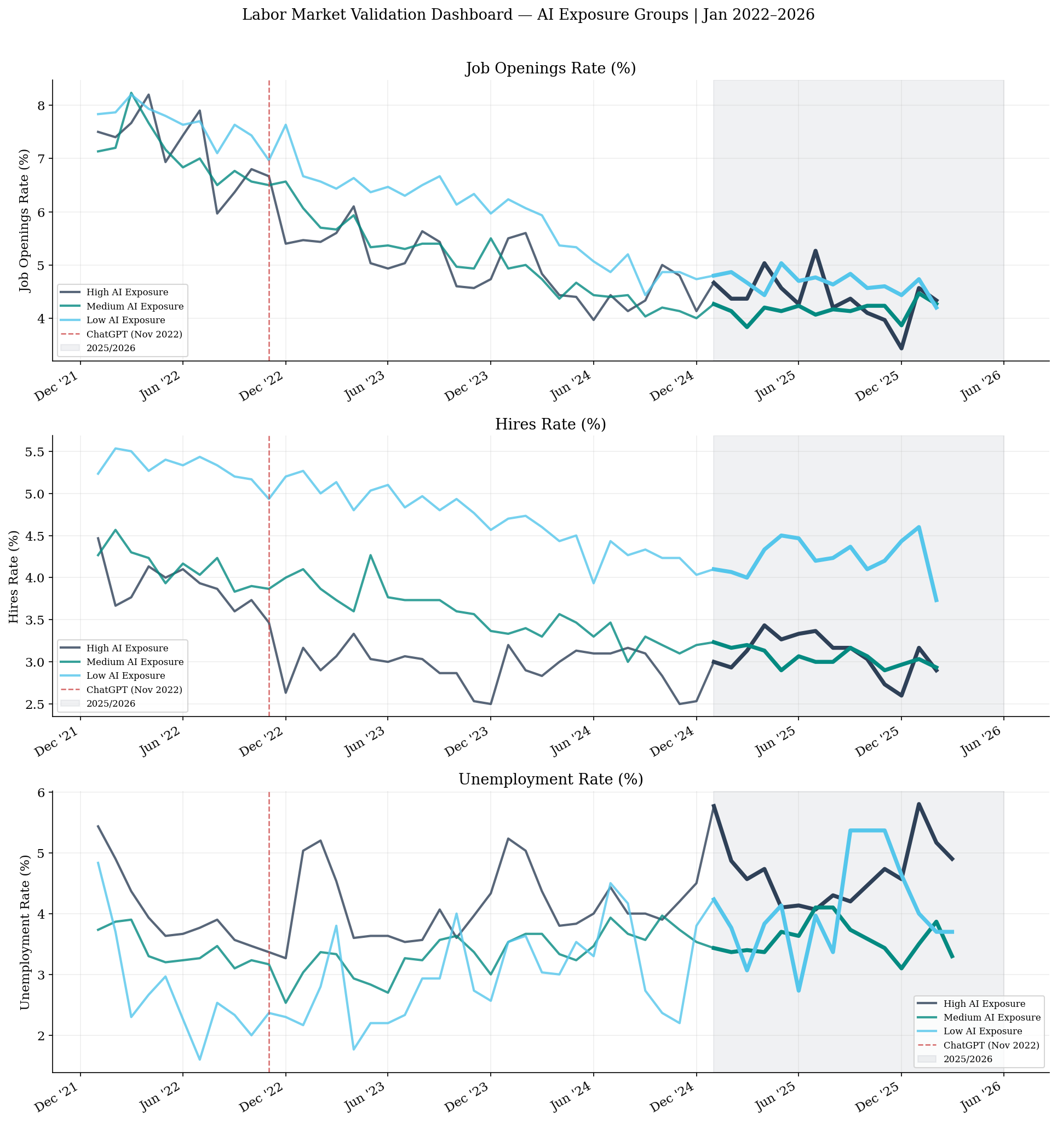
VALIDATION
We checked the aggregate data. Nothing alarming.
Job Openings Rate
Unemployment Rate
Fell equally everywhere
Mixed — no clear pattern
No AI signal
Ambiguous
So we dug deeper.
Aggregate data is too coarse to detect occupation-level displacement.
Time to look at actual companies.
AIOE–JOLTS Correlation
r = 0.50, p = 0.21
Underpowered (N=8)

Slide 5
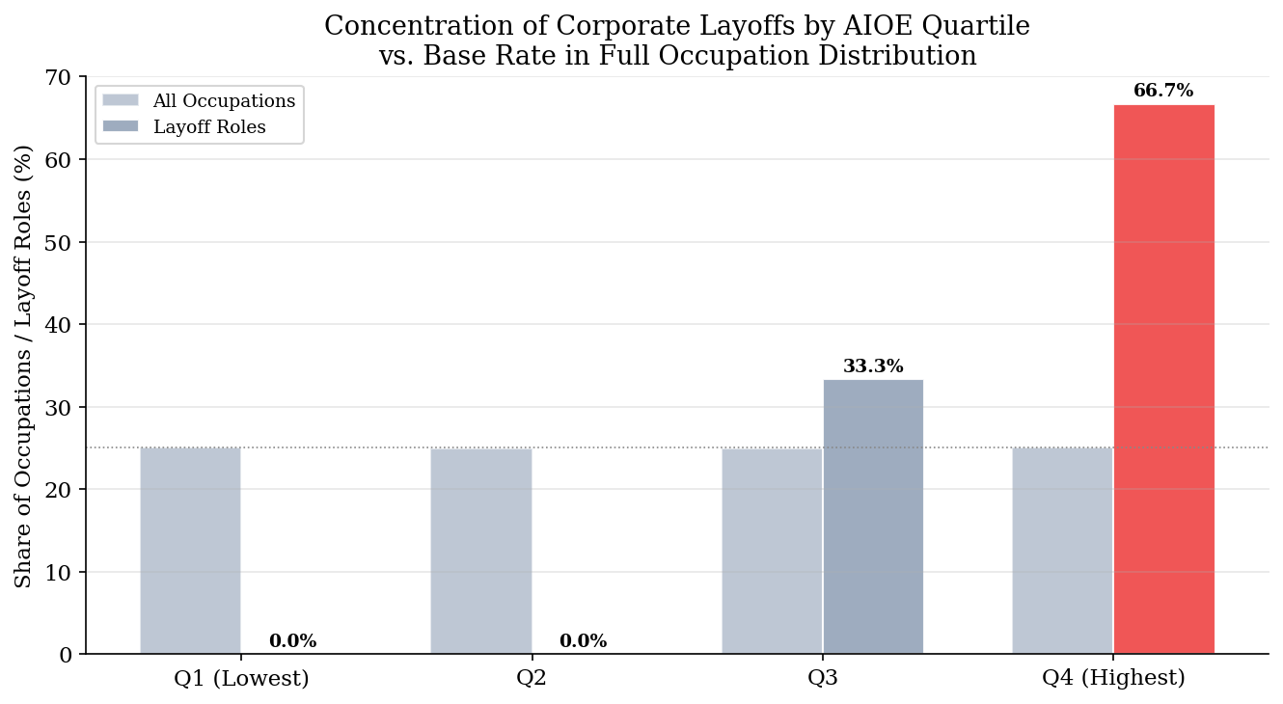
CASE STUDIES
The layoffs ARE happening — in exactly the jobs the model predicted.
66.7%
of laid-off roles fall in the
top AIOE quartile
Expected by chance: 25%
t = +7.55 | p < 0.001
21 companies · 9 industries · 139,640 layoffs
Google
Microsoft
IBM
Goldman Sachs
UPS
Citigroup
BT Group
Salesforce

Slide 6
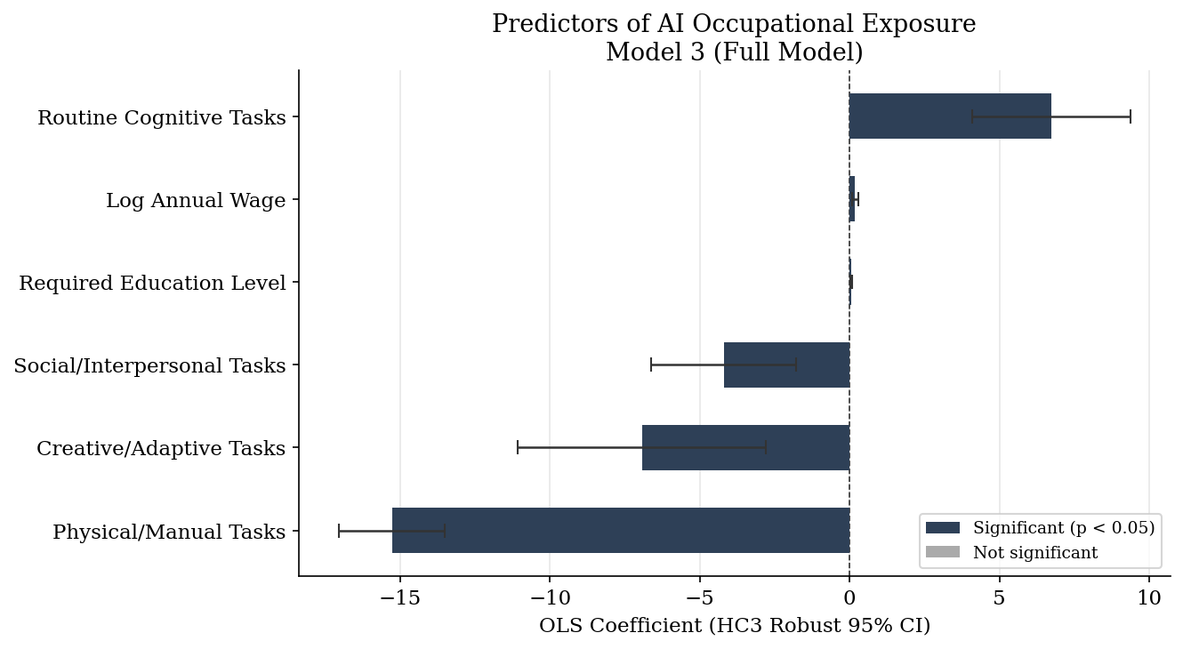
STAGE 1: REGRESSION
What makes a job structurally vulnerable to AI?
AIOE = β₀
+ 6.73 (Routine Cognitive)
− 4.20 (Social)
− 15.28 (Physical/Manual)
− 6.94 (Creative)
+ 0.061 (Education)
+ 0.186 (Log Wage)
R² = 0.831
83% of AIOE variance explained by task structure
PROTECTS: Physical tasks (−15.28***)
THREATENS: Routine Cognitive (+6.73***)

Slide 7
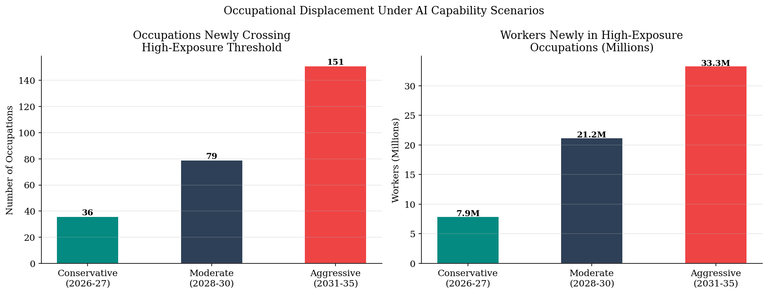
STAGE 2: PROJECTIONS
If AI keeps improving at measured rates...
Conservative
Moderate
Aggressive
2026–2027
2028–2030
2031–2035
7.9M
21.2M
33.3M
newly at-risk workers
newly at-risk workers
newly at-risk workers
Calibrated to:
METR (2025)
AI capability doubling every 7 months
Stanford AI Index (2025)
Inference costs fell 280× in 18 months

Slide 8
STAGE 3: SETUP
What policy tools do countries have — and do they matter?
Country
UI Rate
UI Duration
ALMP Spend
Key Tool
CS
Customer Service Rep
CL
Construction Laborer
US Baseline
40%
6 months
0.1% GDP
None
SOC 43-4051
SOC 47-2061
HIGH RISK
LOW RISK
Singapore
20%*
6 months
0.3% GDP
SkillsFuture credits
AIOE baseline
0.956
AIOE baseline
−1.29
Germany
67%
15 months
0.9% GDP
Kurzarbeit
AIOE projected
1.31 ↑
AIOE projected
−1.21
Denmark
90%
24 months
2.0% GDP
Full flexicurity
Displacement
27%
Displacement
2%
*savings-based CPF
Education
3.2 / 9
Education
2.1 / 9
ABM: 50,000 agents | 48 quarters | 3 scenarios | 28.8M decisions
Reskill capacity
0.41
Reskill capacity
0.28
Reskill duration
4–5 qtrs
Reskill duration
5–6 qtrs
Reskill rate/qtr — the number that explains the gap:
6%
20%
14%
25%
US
Singapore
Germany
Denmark

Slide 9
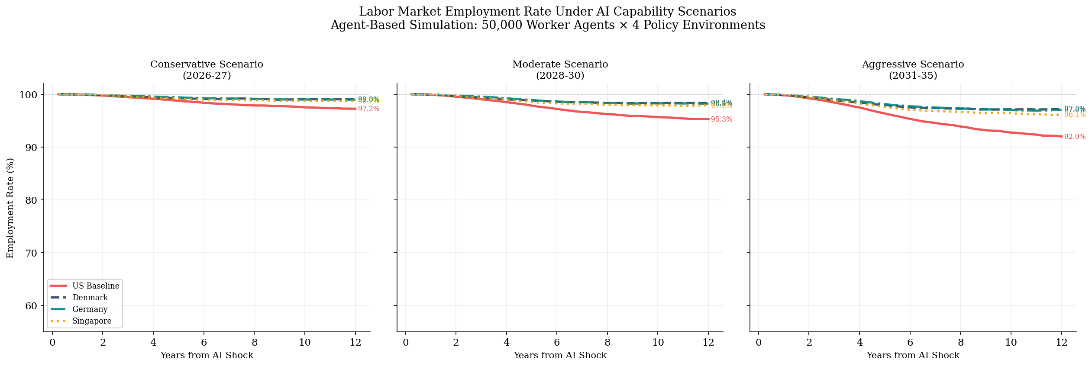
Policy matters more than which AI scenario materializes.
Aggressive Scenario
Year 12
Denmark
97.2%
Germany
97.0%
Singapore
96.1%
US Baseline
92.0%
Gap: 5.2 ppts = ~8.7M workers
The US is the ONLY modeled economy still declining at year 12.
50,000 agents | 48 quarters | 28.8M decisions

Slide 10
Three things to do. Now.
01
Short-Time Work Legislation
Let firms reduce hours + government subsidizes wages instead of layoffs.
Germany's Kurzarbeit model — prevents displacement before it happens.
02
Extend UI: 6 months → 18 months | 40% → 65%
Reskilling takes 2–6 quarters. Current US policy runs out before workers finish retraining.
03
Universal Reskilling Accounts
Every worker gets annual credits for approved training.
Singapore's SkillsFuture model — proactive, not reactive.
"We are cooked." — jk, but actually kind of not. Paper available → dmyers0872@sdsu.edu

